Slide 1

GENERAL INFORMATION
Termoimpianti was established in 2003 and is one of the most qualified companies in Albania regarding the design, implementation, utilization and technical assistance of mechanical, electrical, hydraulic systems, HVAC, BMS realized with contemporary softwares.
Our company is certificated ISO 9001: 2015 and ISO 14001: 2015. During the years Termoimpianti has worked and exchanged experiences with other European companies, some of which are world leaders in the above systems. Termoimpianti possesses a very good reputation in the Albanian market. The company's projects and applications are accomplished according to rigorous standards requirements (BS, DIN, EC, ASHRAE ect).

Slide 2
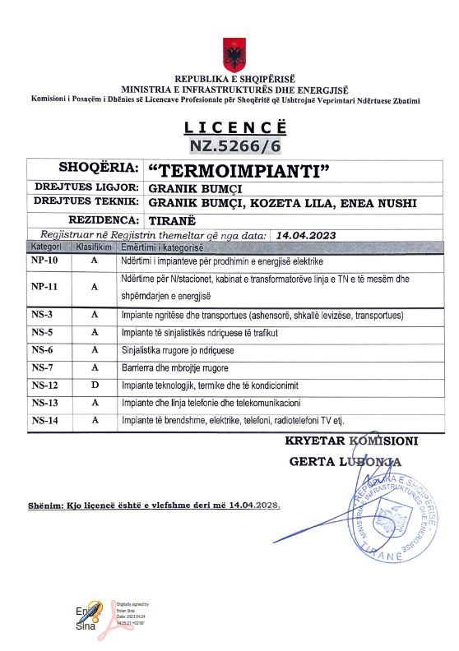
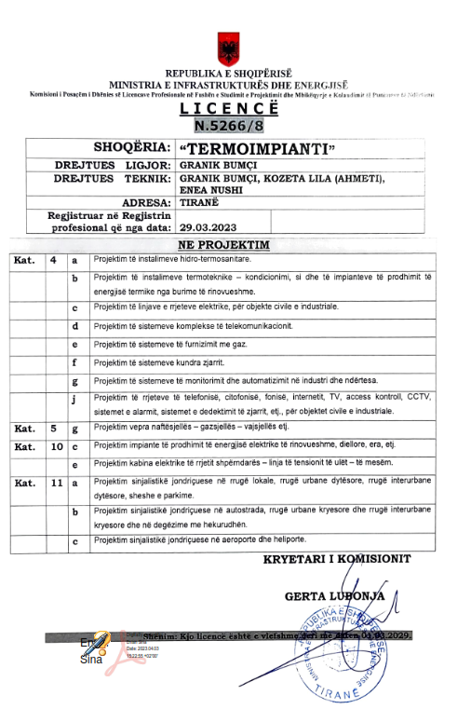
CERTIFICATIONS

Slide 3
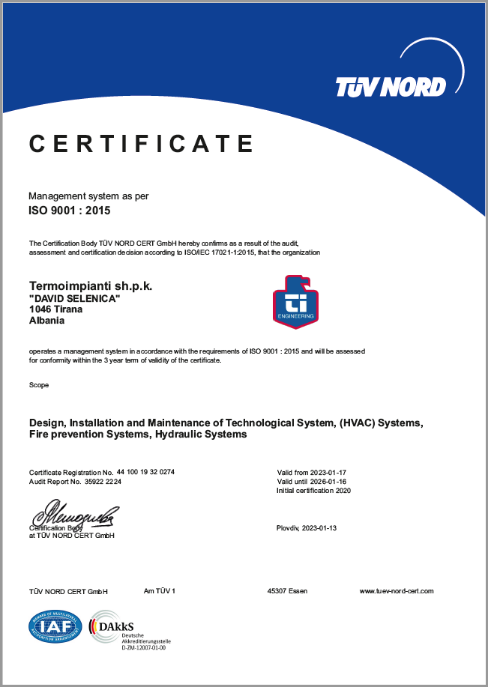
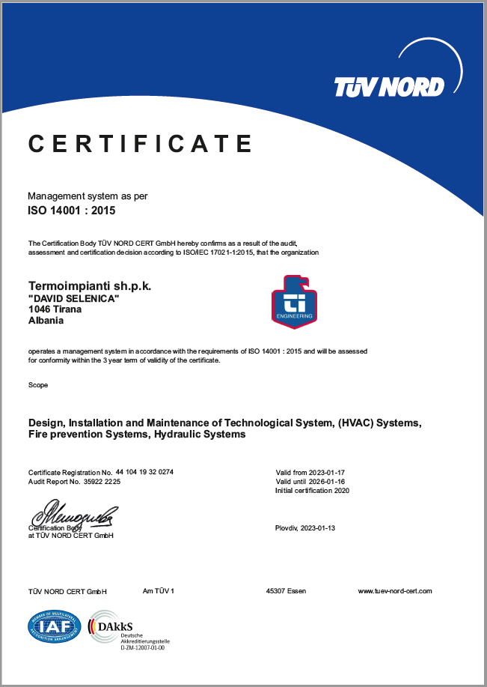
CERTIFICATIONS

Slide 4
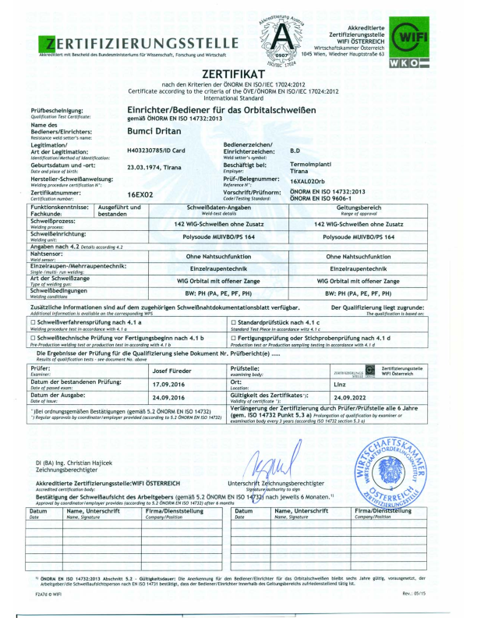
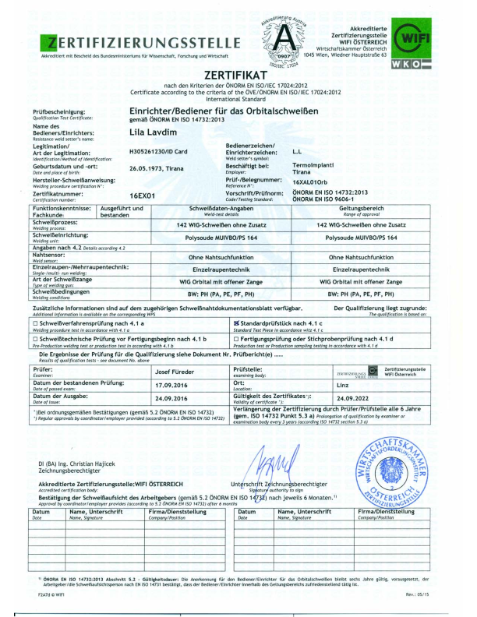
CERTIFICATIONS

Slide 5
ACTIVITY
The company Termoimpianti in its activity offers design, installation, maintenance
services and planned overhauls in the field of:
1- Air conditioning systems HVAC, heating, ventilation of social, civil and industrial
facilities;
2-Close Control systems for data centers and technological rooms.
3- HVAC systems in the pharmaceutical manufacturing industry, hospitals with the
realization of rigorous requirements of the surgery rooms, white rooms
(cleaning rooms), production units where the realization of pressure differences and environment purity are fundamental conditions. Realization of overpressure scales
of the enviroments (automatic or manual) and the required purity in the use of
different environmental filtering scales up to the use of HEPA filters are the target of
the company's work;
4- Line and stations of production of filtered demineralized water, the use of reverse
osmosis filters as well as plants and lines of production and distribution of
pharmaceutical water (WFI – Water For Injection);

Slide 6
4- Industrial steam production stations as well as pure steam for pharmaceutical production. Distribution lines built with 316L stainless steel pipes and membrane valve welded with modern welding machine “Orbital”;
5- Pumping stations and water deposits with relatively large volume and power in civil, social and industrial facilities.
Sanitary water pipeline network, installation of sanitary equipment, production plants and distribution of hot water.
6- Active fire protection systems in social buildings, civil buildings, warehouses, underground and industrial parks realized with hydrant water systems, naspo, classic sprinklers and finally watermist systems (nebulized water) production etea sicureza - italy, as well as fire protection of special facilities (server centers, archives and libraries ect) with inert gas.
7- Measurement, control, automatic regulation, registration( bms moritoring e control system for buildings ) for all types of air, water, steam, and gases parameters.

Slide 7
MISSION
Our mission is to be the chosen partners for the implementation of all the systems of our activity, as well as providing optimal functional and energy solutions in these fields.
We have set ourselves the aim to influence positively in our clients' success and to be valued and respectful partners in the future, also have a positive impact on the natural environment as well.

Slide 8
















PARTNERS

Slide 9
ADMINISTRATOR
PROJECT MANAGEMENT
- Organization on site
- Implementation on the site
- Technical security
- Project adaptation to the fact
DESIGN OFFICE
- Realization of the Project
- Customer relationships
- Preparation of economic offers
FINANCE
LOGISTICS
TECHNICAL STAFF
- Maintenance
- Repairs / Emergency
- Working Hours::
7 days a week 07.00 -19.00
Technical Hydraulic Staff
Technical Welder Staff
Technical Staff HVAC Specialist
ORGANIZATION
Engineer : 10
Technics, Specialist 30-55
Financier 3
TOTAL STAFF : 40-70

Slide 10
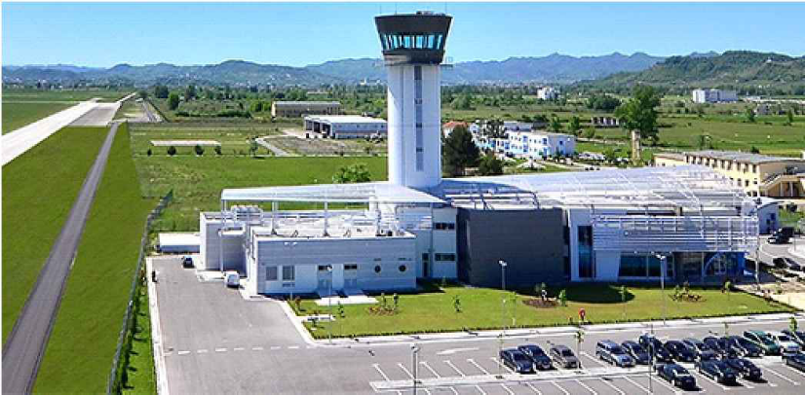
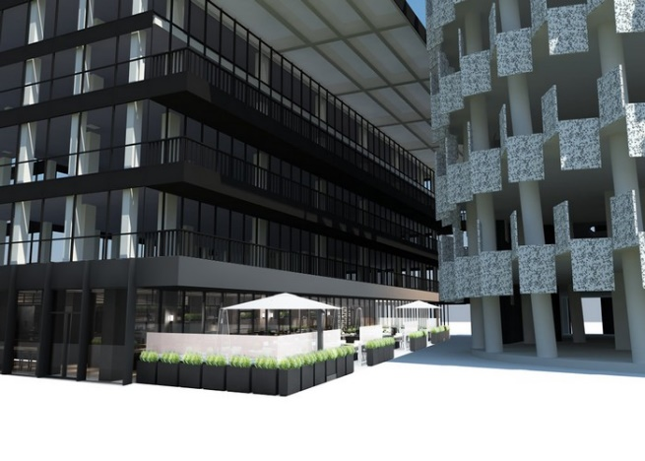
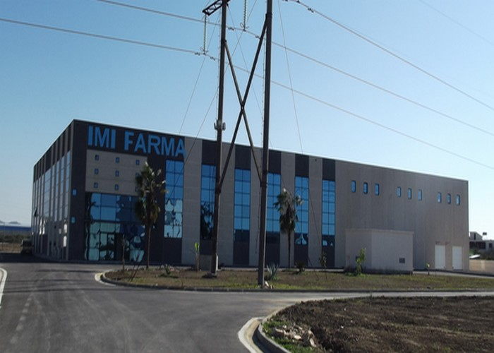
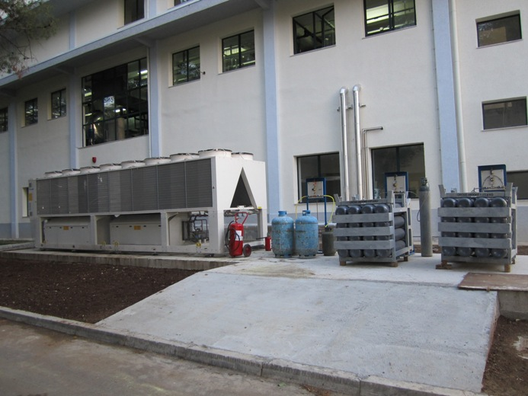
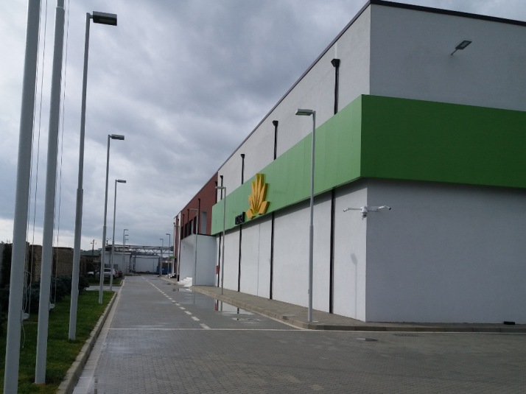
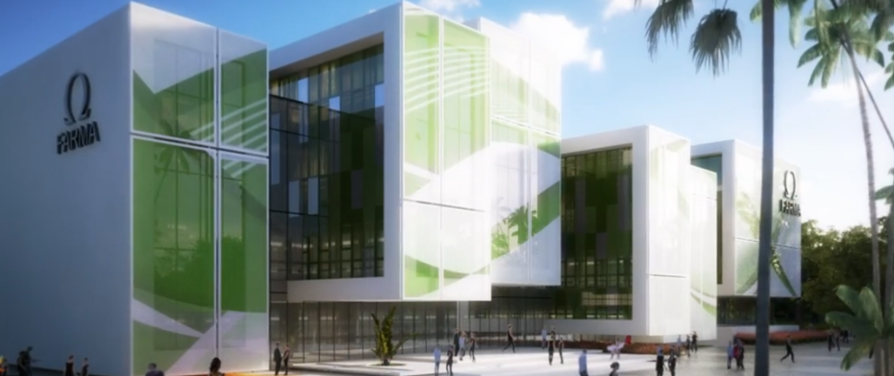
COMPLETED FACILITIES
‘’NENE TEREZA” AIRPORT
CONTROLL TOWER “A.N.T.A.”
TID TOWER – TIRANA
“IMI” PHARMA
OMEGA PHARMA
PROFARMA
“NOVAL” PHARMACEUTIC

Slide 11
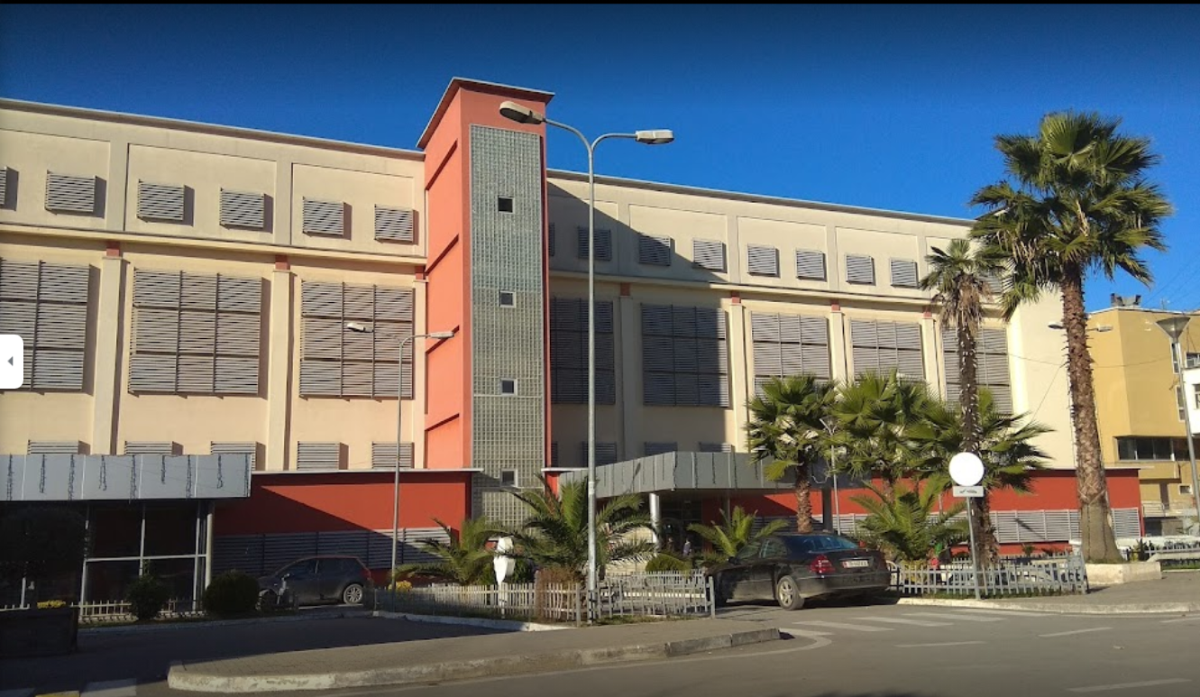
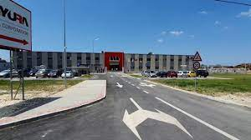
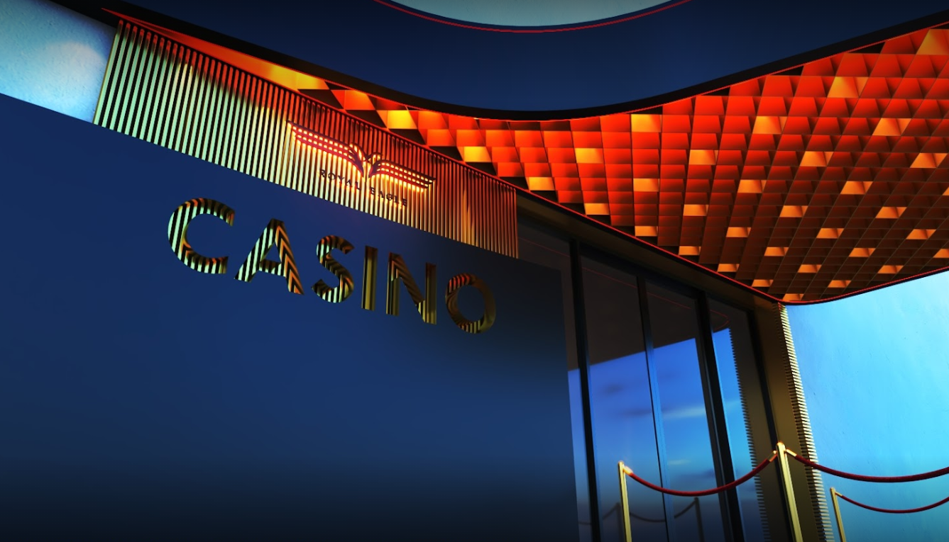
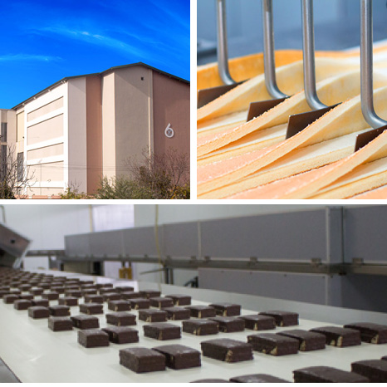
COMPLETED FACILITIES
TIRANA UNIVERSITY HOSPITAL
CENTER “TUHC” A1 BUILDING
YURA CORPORATION FIER, ALBANIA
“ROYAL EAGLE CASINO”
MAK HOTEL ALBANIA
INSIFA LTD DURRES, ALBANIA

Slide 12
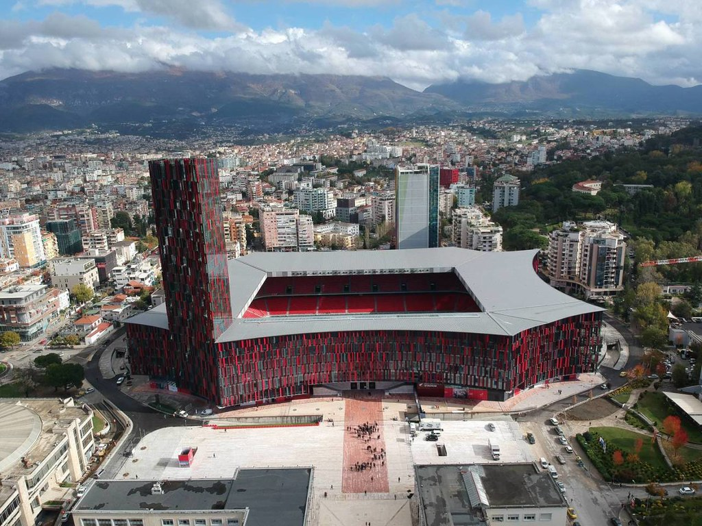
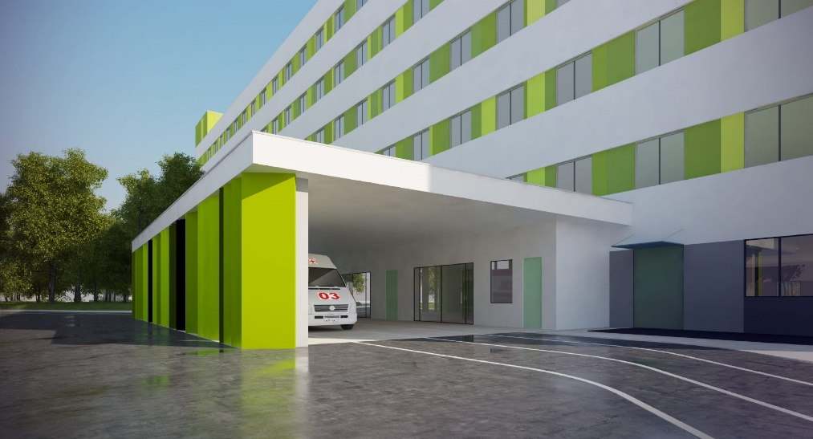
ONGOING PROJECTS
TIRANA UNIVERSITY HOSPITAL
CENTER “TUHC” A2 BUILDING
“AIR ALBANIA CASINO”
TIRANA,ALBANIA

Slide 13
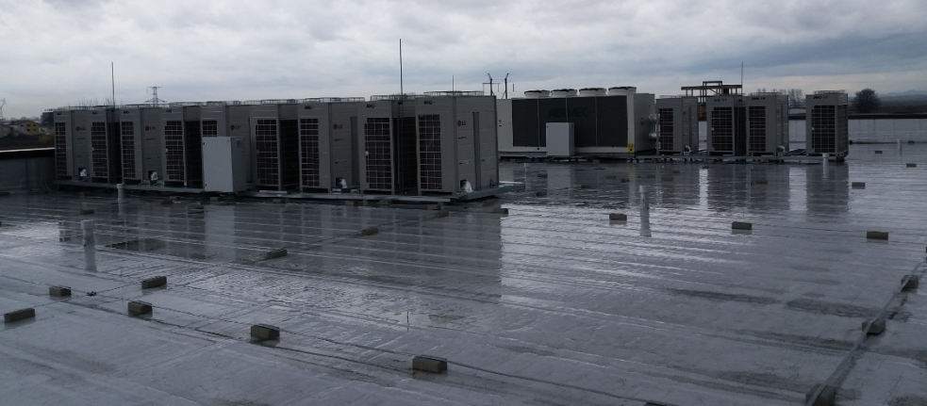
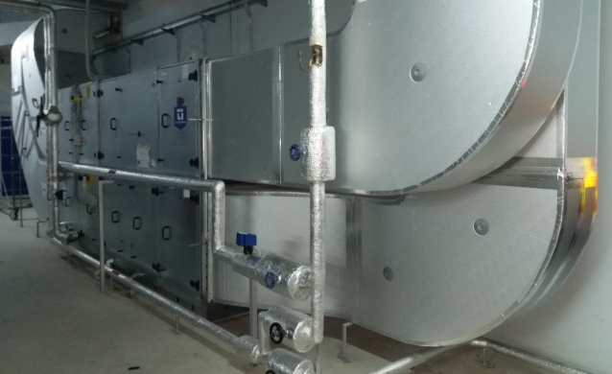
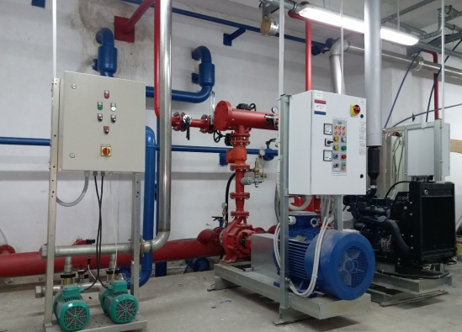
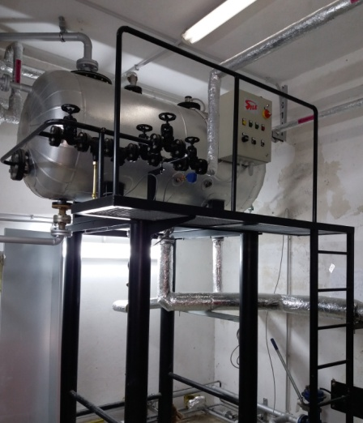
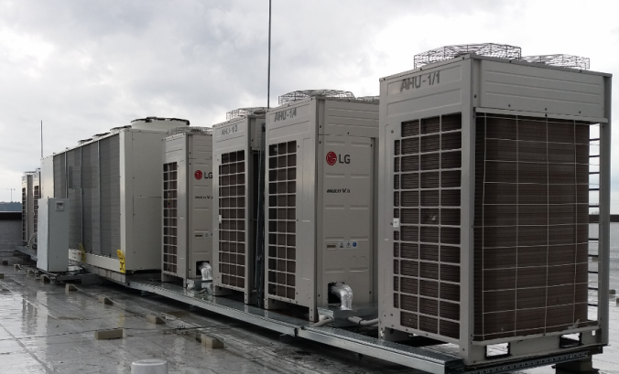
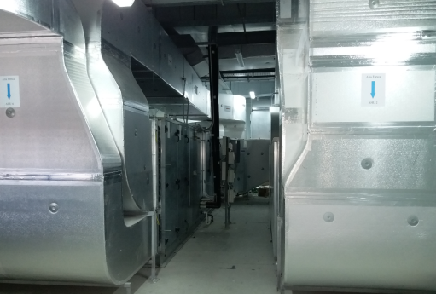
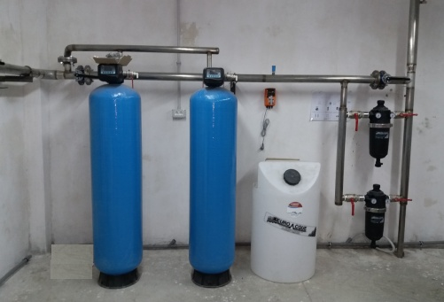
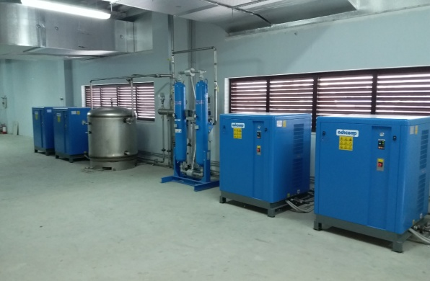
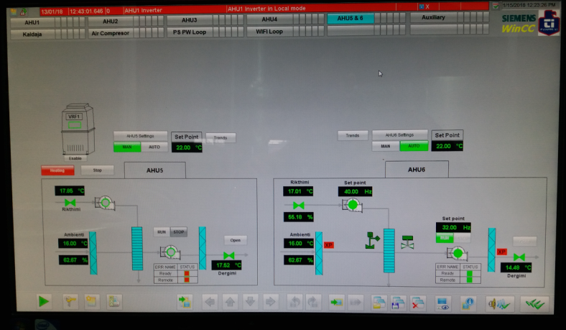
Pharmaceutical Manufacturing Factory " NOVAL ", Xhafzotaj, Durrës
Supply / Installation / Design of Heating / Cooling systems and Ventilation (HVAC);
Fire protection, Hydraulic and Drainage systems;
Steam production station and distribution system;
Pharmaceutical water production and its distribution system;
Automation of technology. Start-up and projects according to the fact;
Period 2016-2017

Slide 14
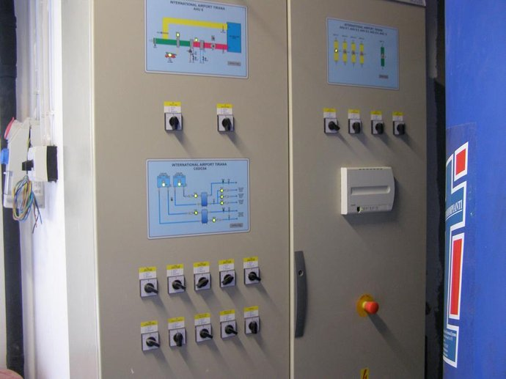
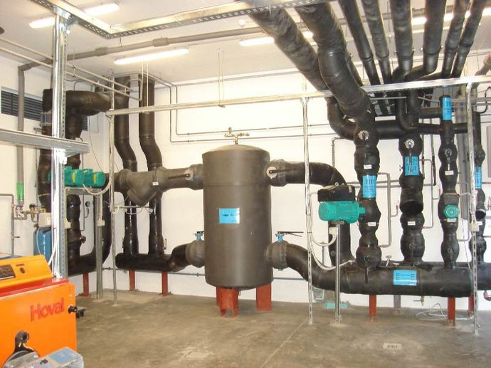
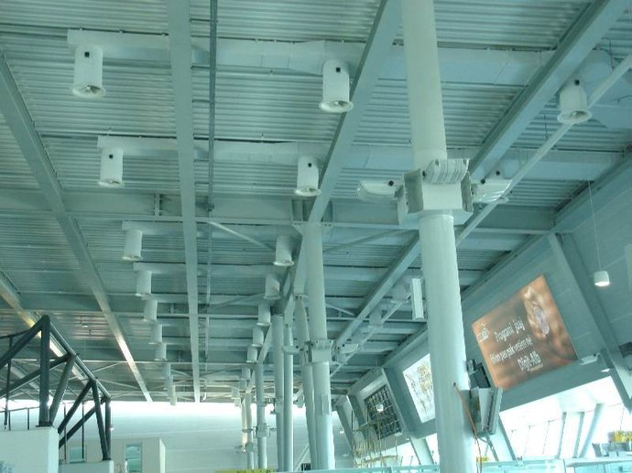
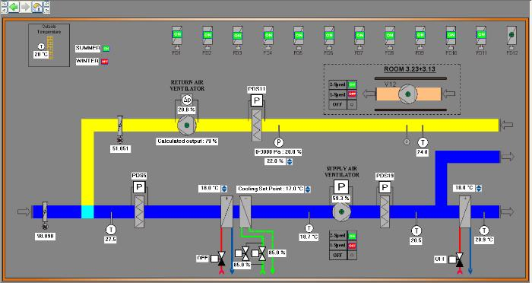
‘Nene Tereza’ Airport , Pasanger Terminal and Cargo, ANTA
Supply / Installation / Design of Heating / Cooling systems and Ventilation (HVAC);
Fire protection, Hydraulic and Drainage systems;
Steam production station and distribution system;
Pharmaceutical water production and its distribution system;
Automation of technology. Start-up and projects according to the fact;
Period 2009-2011

Slide 15
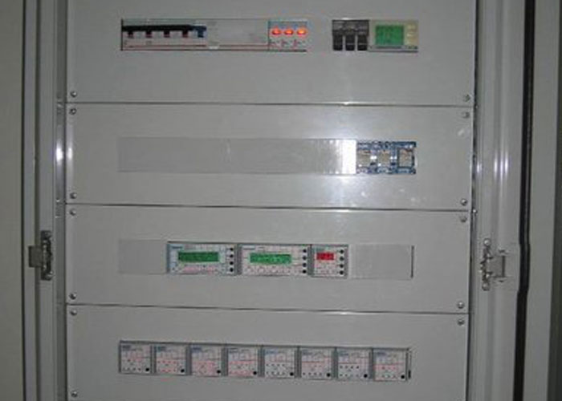
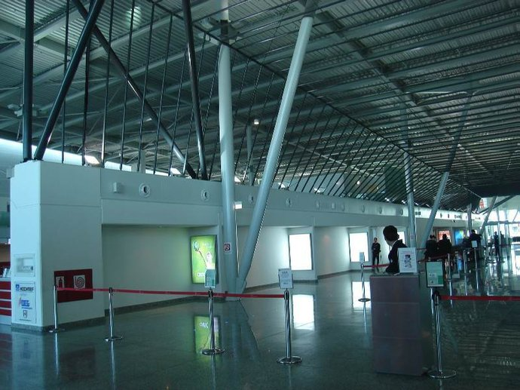
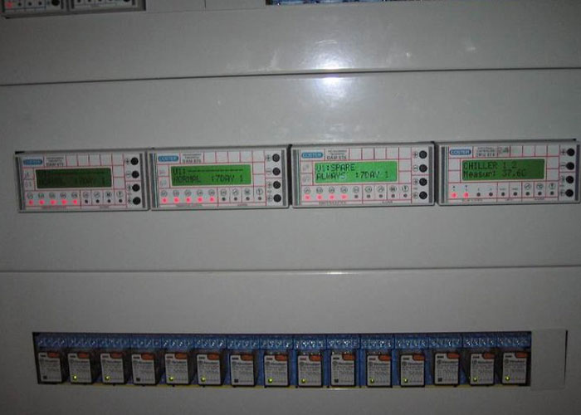
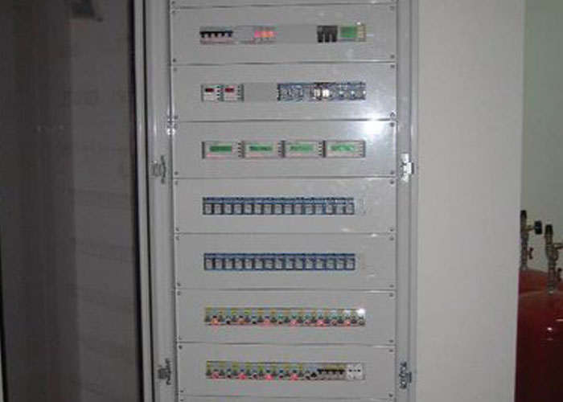
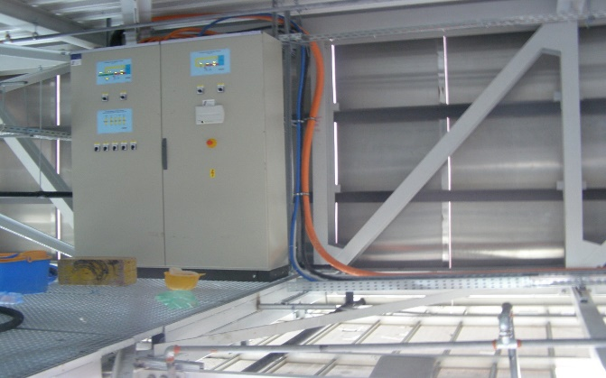
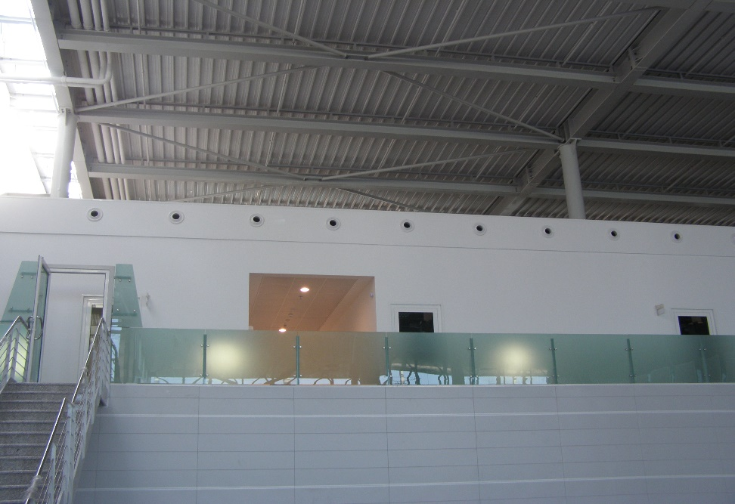
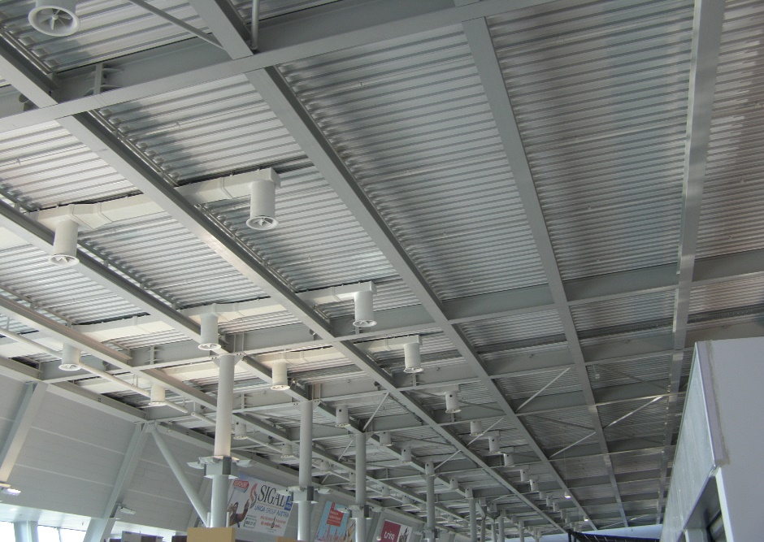
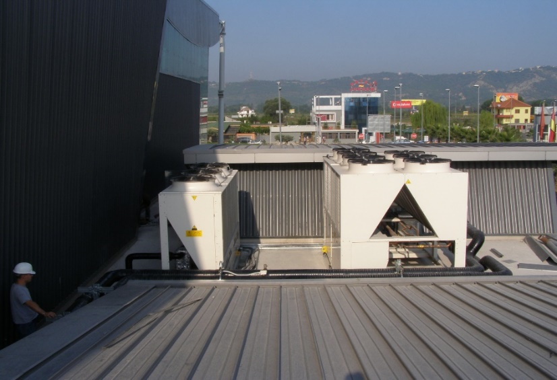
‘Nene Tereza’ Airport , Pasanger Terminal and Cargo, ANTA

Slide 16
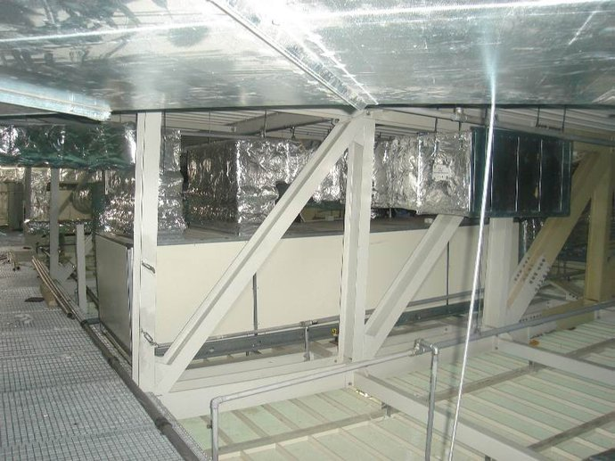
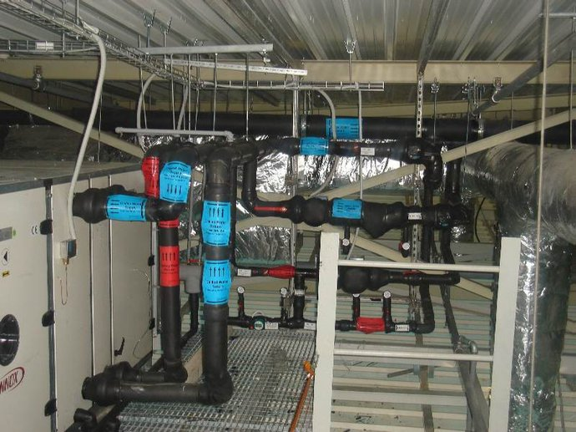
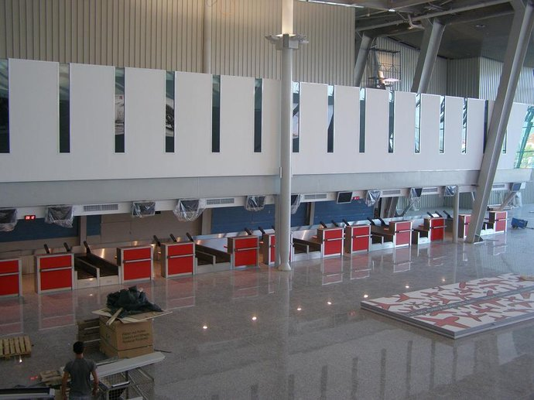
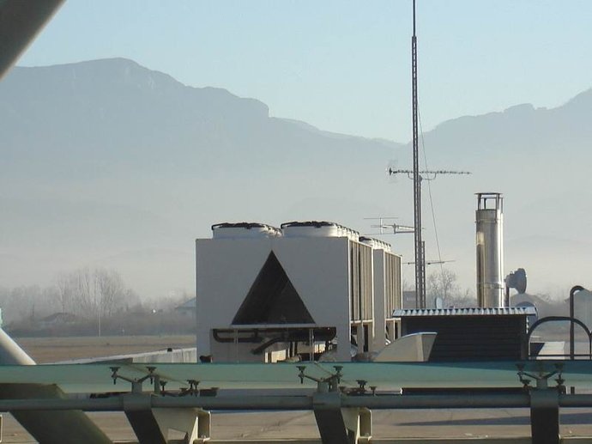
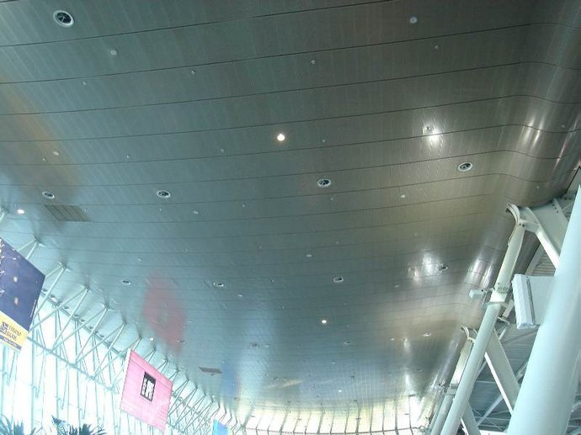
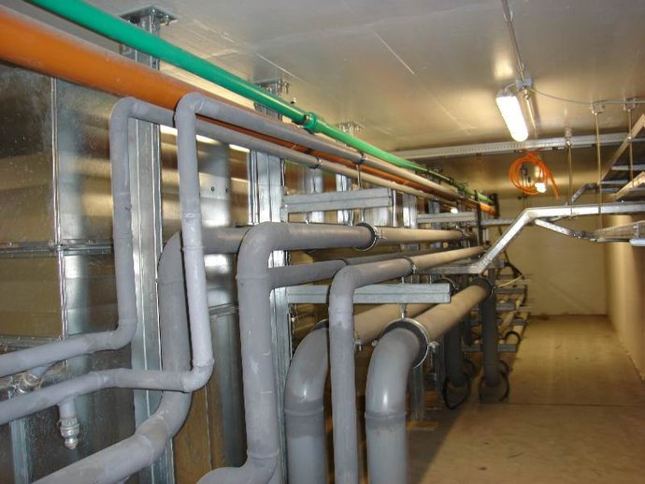
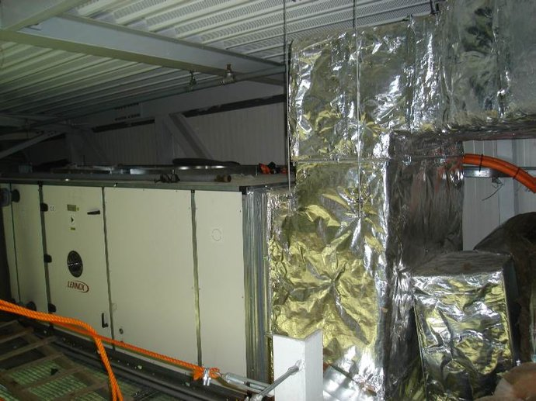
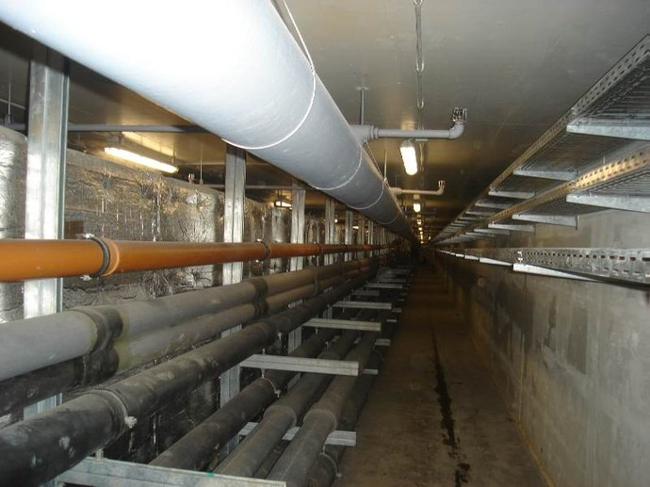
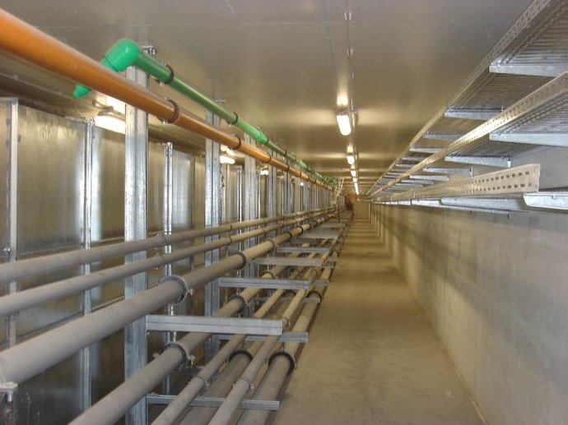
‘Nene Tereza’ Airport , Pasanger Terminal and Cargo, ANTA

Slide 17
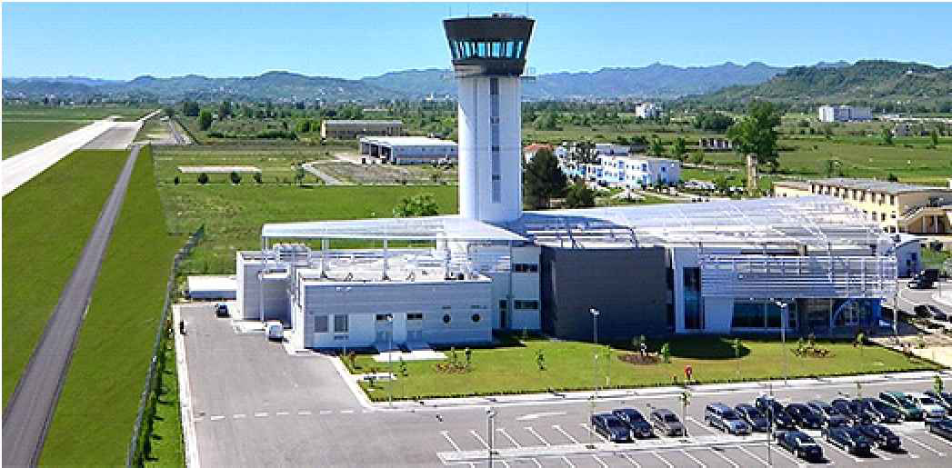
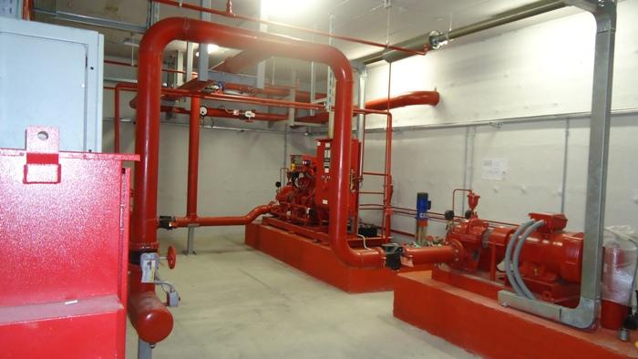

ANTA Rinas Tirana

Slide 18






ANTA Rinas Tirana
FIRE SUPPRESSION SYSTEM FM200 Level +0.0

Slide 19







ANTA Rinas Tirana
FIRE SUPPRESSION SYSTEM FM200 Level +1

Slide 20



ANTA Rinas Tirana

Slide 21



IT Precize Cooling ANTA Rinas Tirana

Slide 22






Propharma SH.A-Tirana and MIBEGMBH Brehna-Germany
Supply / Installation / Design of Heating / Cooling systems and Ventilation (HVAC);
Fire protection, Hydraulic and Drainage systems;
Steam production station and distribution system;
Pharmaceutical water production and its distribution system;
Automation of technology. Start-up and projects according to the fact;
Period 2010-2011

Slide 23



“IMI” PHARMA
Supply / Installation / Design of Heating / Cooling systems and Ventilation (HVAC);
Period 2014-2015

Slide 24




TID TOWER TIRANA
Supply / Installation / Design of Heating / Cooling systems and Ventilation (HVAC);
Period 2015-2016

Slide 25



INDUSTRIAL FACILITIES Cement Factory Elbasan

Slide 26



INDUSTRIAL FACILITIES Aluminum Ingots Foundry

Slide 27









OMEGA PHARMA GROUP
Supply / Installation HVAC System
Fire Fighting System
Water Supply/Discharge System
Period 2018

Slide 28









Tirana University Hospital Centre (TUHC) Reform A1 Building , Phase II
Supply / Installation Mechanical System (HVAC, Fire protection, Sanitary system) Heating steam and Cooling water,
Surgical room and Medical Gas Systems
Start-up and projects according to the fact;
Period 2019

Slide 29






INTESA SANPAOLO BANK ALBANIA
Central Branch

Slide 30






INTESA SANPAOLO BANK ALBANIA Central Branch

Slide 31

IT Precize Cooling Intesa Sanpaolo Bank Albania Head Office
Supply / Installation HVAC System
Fire Fighting System
Period 2016-2017

Slide 32








Medikamenta I & II
Supply / Installation HVAC System
Fire Fighting System
Water Supply/Discharge System
Period 2013-2017

Slide 33

INSIFA 1 Ltd
ALBANIA
Food Production Company

Slide 34







YURA Corporation Fier
Supply / Installation HVAC System
Period 2020

Slide 35







ROYAL EAGLE CASINO
Supply / Installation HVAC System
Period 2021

Slide 36










Tirana University Hospital Centre (TUHC) Reform A2 Building , Phase II

Slide 37










CASINO AIR ALBANIA

Slide 38
OTHER PROJECTS
- Alleance Central Site - The building dedicated for the production of the new ID cards:
- Serious Crime Court Tirana
- Pre-trial detention centre, Vlora (8 000 square meter construction surface)
- Commercial, Business and Residential edifices at Street “Bardhok Biba“ Tirana
(19 500 square meter)
- Commercial, Business and Residential edifices at “Selite” for BEST CONSTRUCTION Tirana
(20 000 square meter)
- Commercial, Business and Residential edifices at BEST CONSTRUCTION
Headquarter office Tirane(Main DHL office,Main Banka Popullore office etc)
(2800 square meter)
- Military Building (Restaurant 2 floors 3000 square meter) SHKODER (NATO INVESTEMENT
- Commercial, Business and Residential edifices at Rruga “4 Shkurtit“ “Green Park 2”
(14 000 square meter)
- Commercial, Business and Residential edifices at Piazza “Karl Topia“ Tirana,
(31 200 square meter)

Slide 39





REFERENCES

Slide 40
THANK YOU FOR YOUR ATTENTION!

